Slide 1
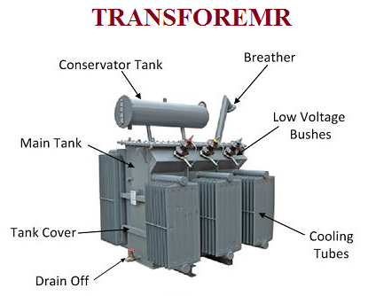
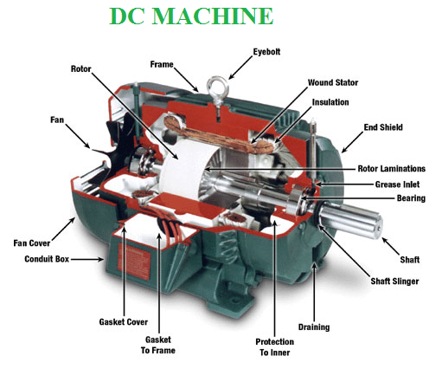
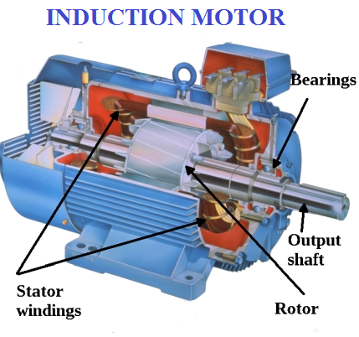
UNIT-III: Fundamentals of Electrical Machines

Slide 2
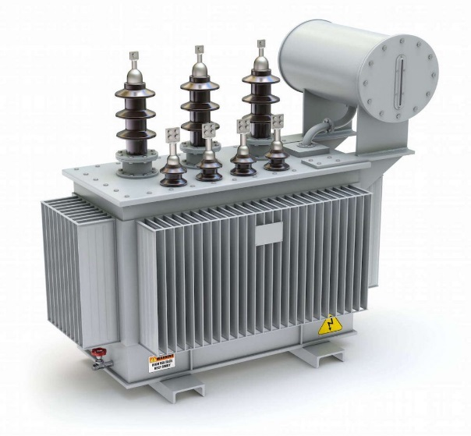
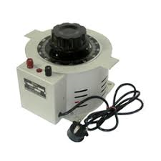

TRANSFORMER
Principle of Operation: Mutual inductance and mutual coupling phenomena in transformer
Construction
Working
Concept of Turns Ratio
Applications
Transformer on DC
Autotransformer
Instrument transformers

Slide 3
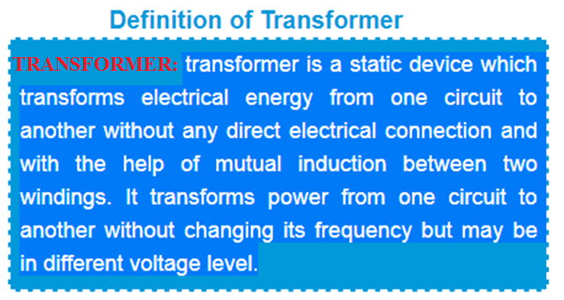
In Brief, A transformer is a static electrical device that transfers electrical energy between two or more circuits through electromagnetic induction.

Slide 4
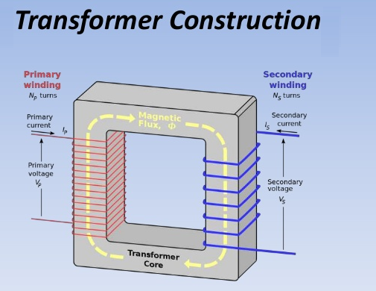

Slide 5
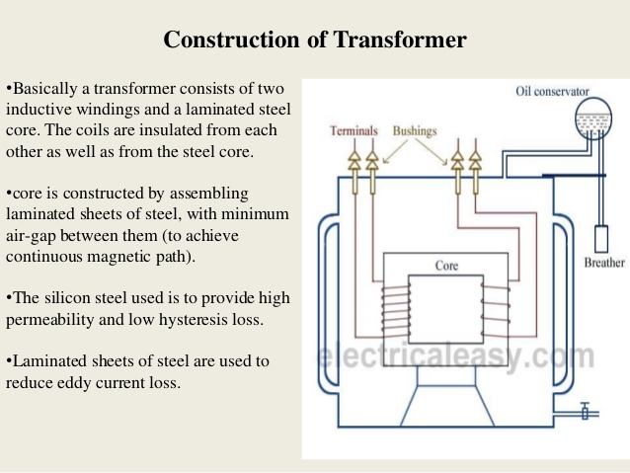

Slide 6
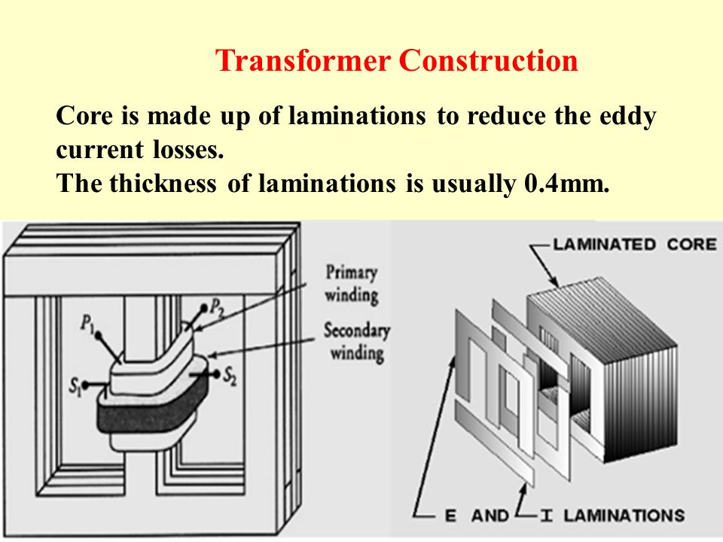

Slide 7
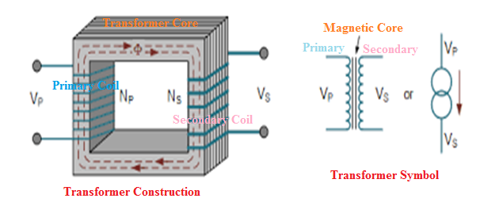
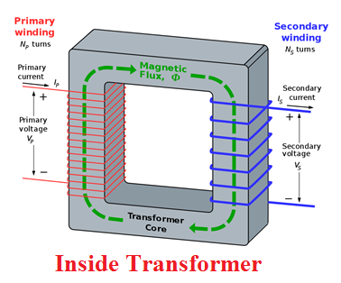
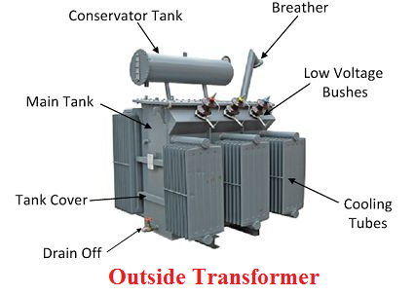
TRANSFORMER SYMBOLS

Slide 8
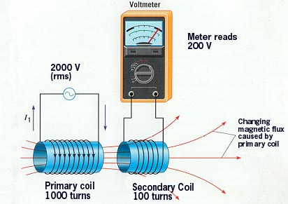
Principle of operation
It is based on principle of MUTUAL INDUCTION. According to which an e.m.f. is induced in a coil when current in the neighbouring coil changes.

Slide 9
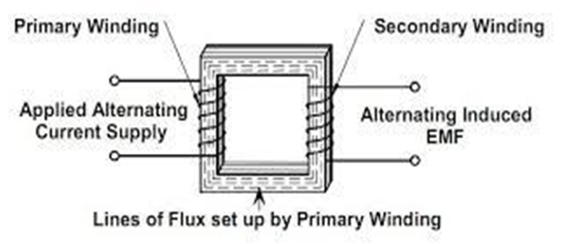
PRINCIPLE OF TRANSFORMER It works on the principle of Electromagnetic induction. The current flowing in the primary winding of the transformers creates a magnetic field, magnetic flux flows to the secondary side of the transformers, which induces EMF in the winding and current flows when the circuit is closed.
A varying current in one coil of the transformer produces a varying magnetic field, which in turn induces a varying electromotive force (emf) or "voltage" in a second coil.

Slide 10
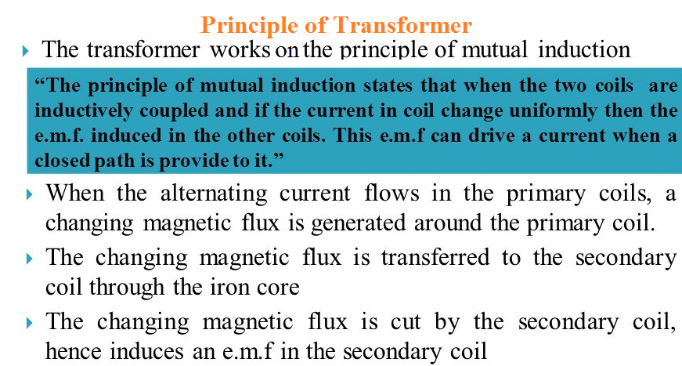

Slide 11
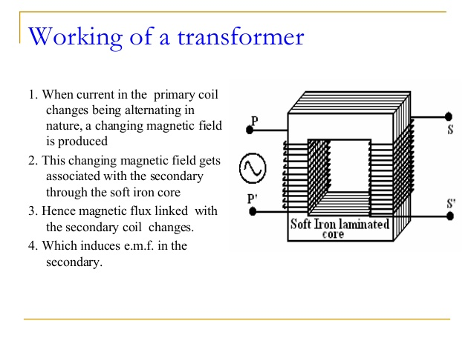

Slide 12
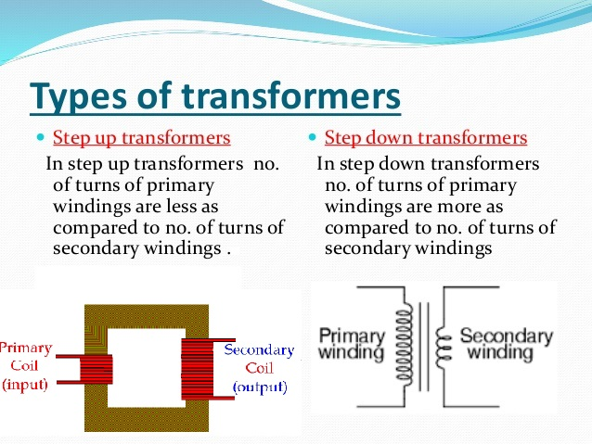

Slide 13
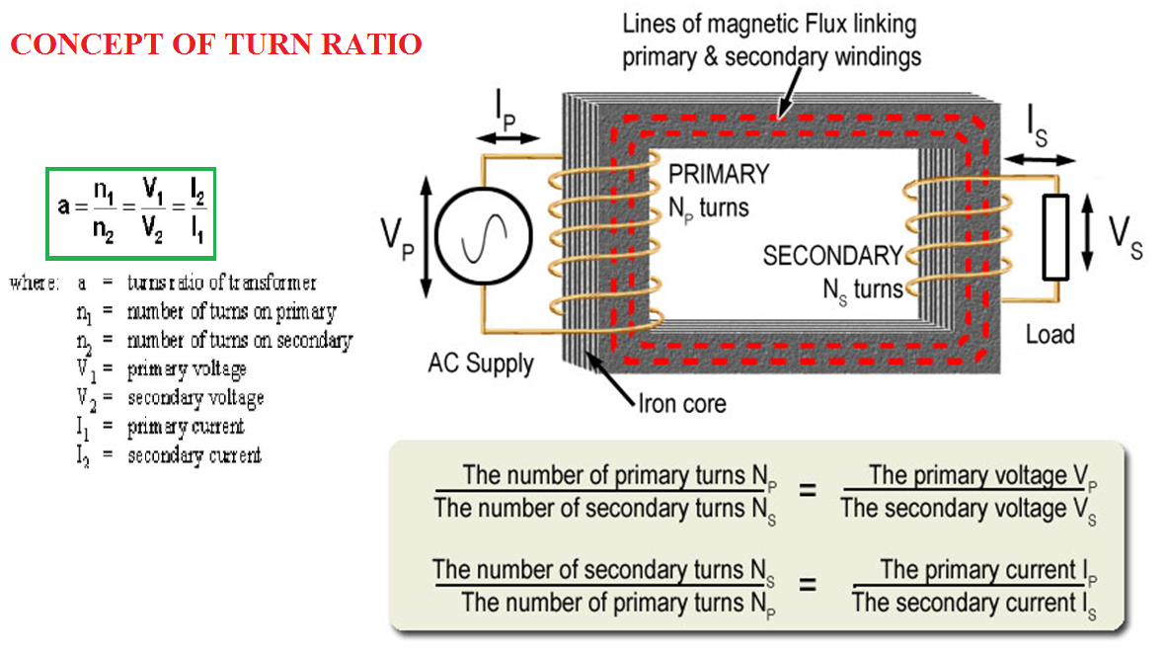

Slide 14
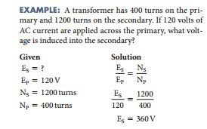

Slide 16
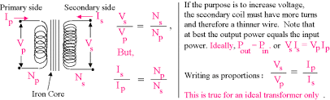
Notes:
16

Slide 17
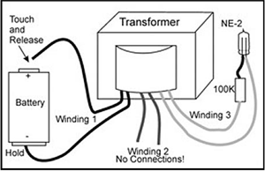
TRANSFORMER ON DC SUPPLY
What will happen if the Primary of a Transformer is Connected to D.C. Supply????

Slide 18
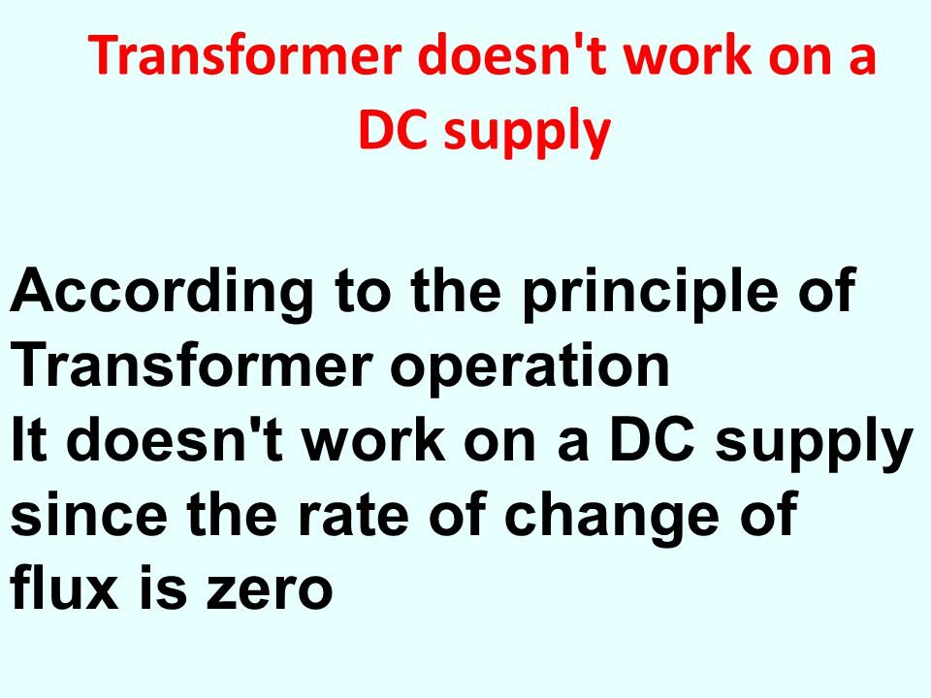

Slide 19
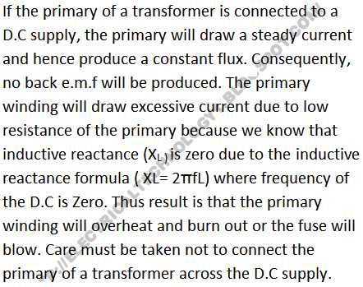

Slide 20
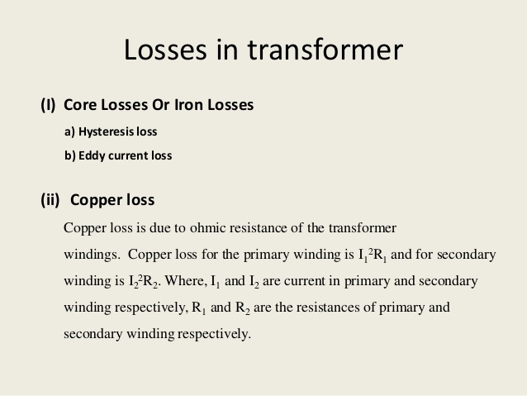

Slide 21
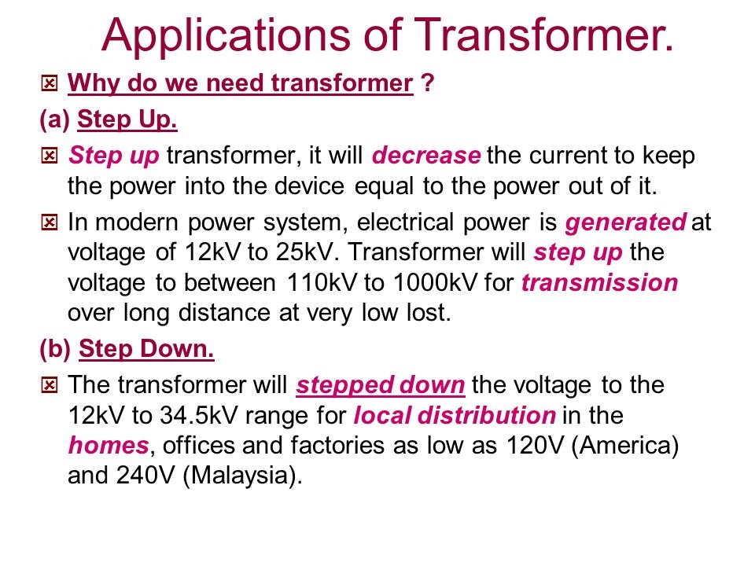

Slide 22
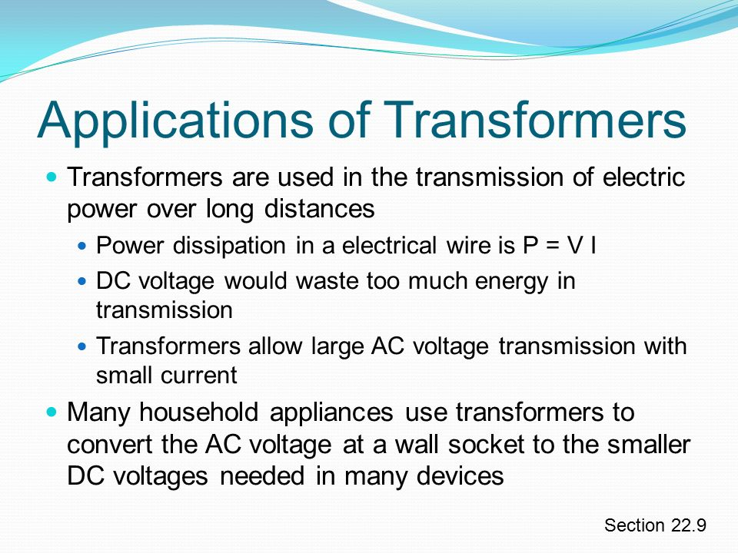

Slide 23
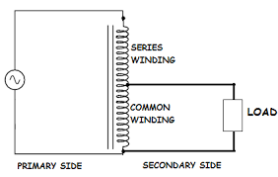
Auto-Transformer
An Auto-transformer is an electrical transformer with only one winding.

Slide 24
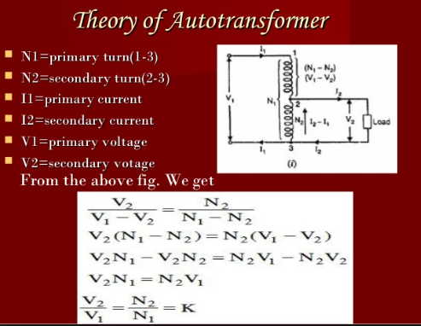

Slide 25
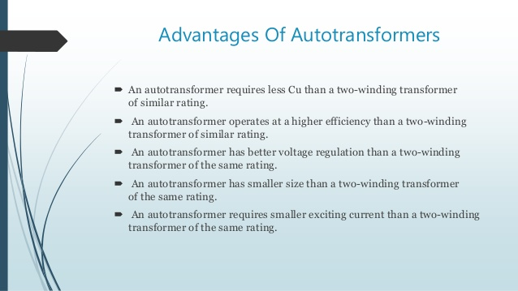

Slide 26
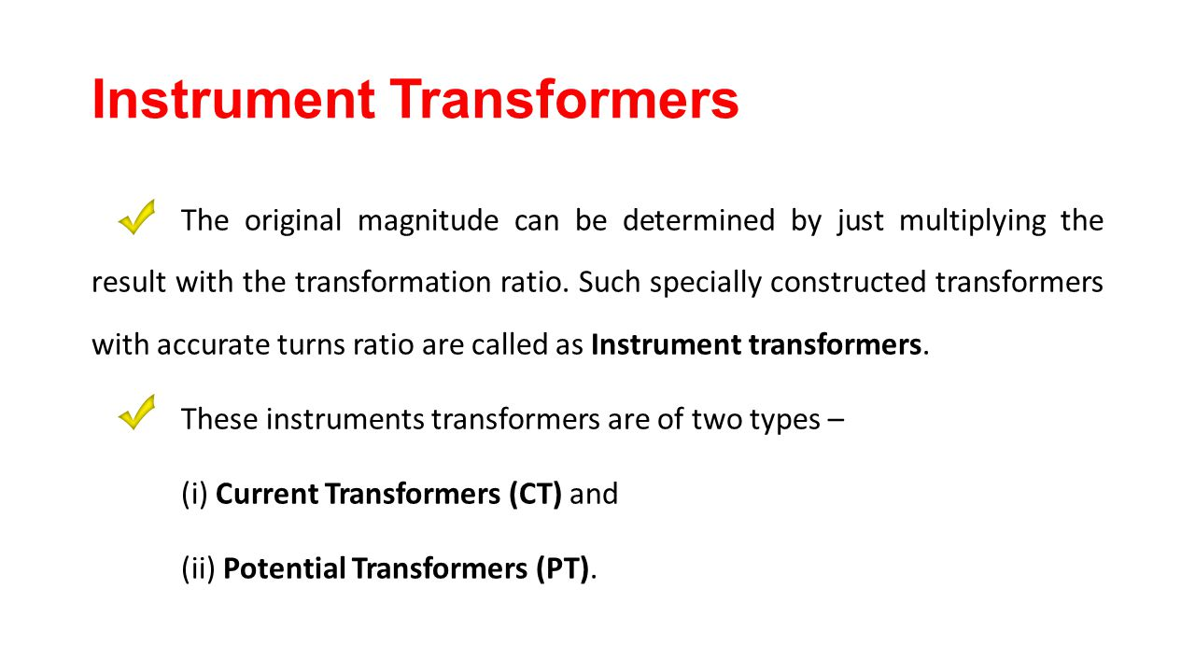

Slide 27
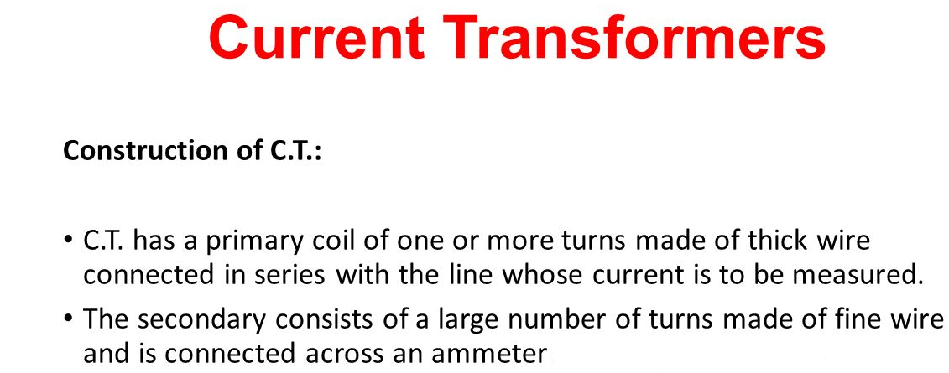
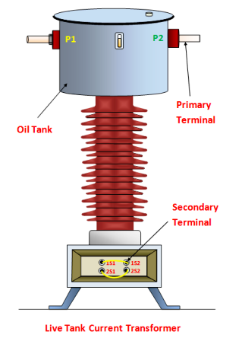
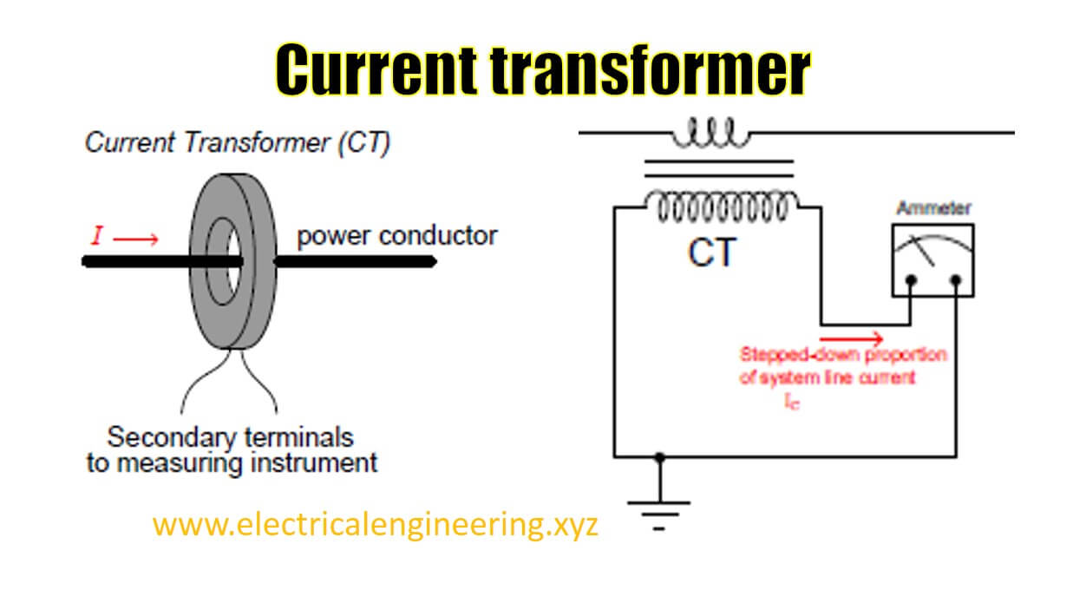

Slide 28
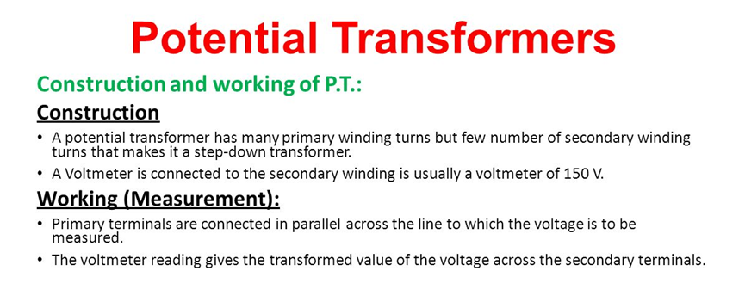
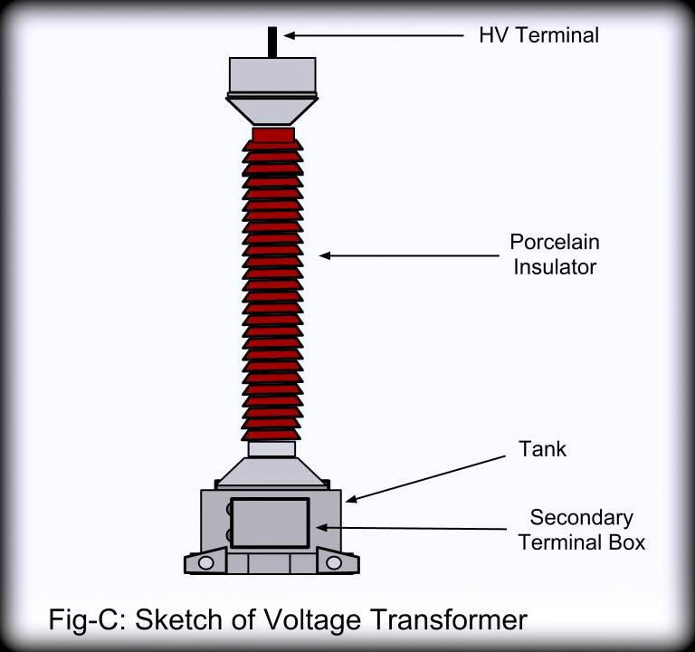
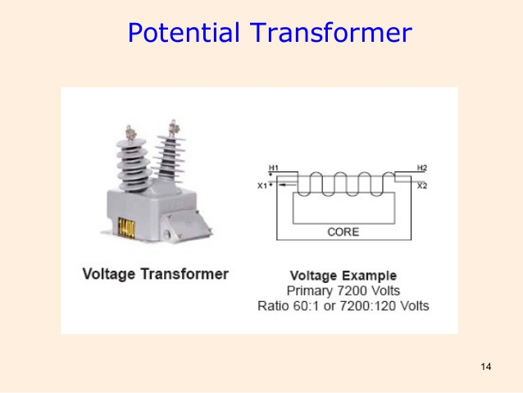

Slide 29
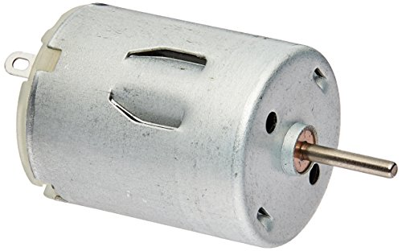
DC MACHINES
DC MOTOR
DC GENERATOR
Working principles
Classification
Starting of DC Machines
Speed control of DC Motor
Applications of dc motors

Slide 30
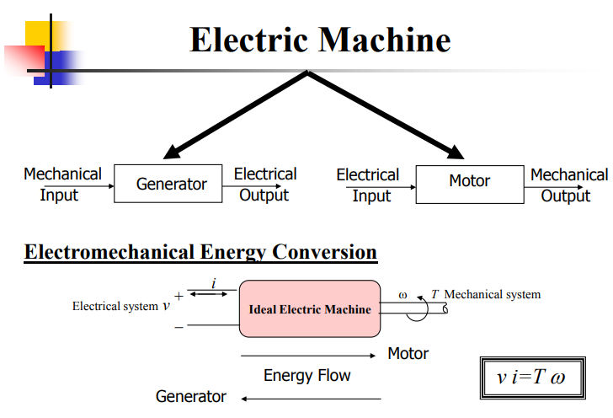

Slide 31
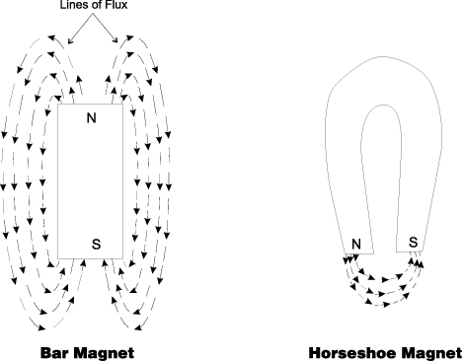
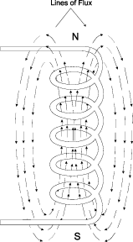
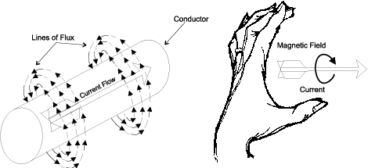
Review of magnetism
Lines of flux define the magnetic field and are in the form of concentric circles around the wire.
The magnetic lines around a current carrying conductor leave from the N-pole and re-enter at the S-pole.
"Left Hand Rule" states that if you point the thumb of your left hand in the direction of the current, your fingers will point in the direction of the magnetic field.
The flow of electrical current in a conductor sets up concentric lines of magnetic flux around the conductor.
31

Slide 32
Fleming’s left hand rule
Used to determine the direction of force acting on a current carrying conductor placed in a magnetic field .
The middle finger , the fore finger and thumb of the left hand are kept at right angles to one another .
The middle finger represent the direction of current
The fore finger represent the direction of magnetic field
The thumb will indicate the direction of force acting on the conductor .
This rule is used in motors.

Slide 33
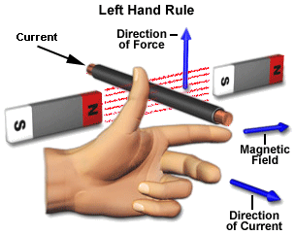
Fleming’s left hand rule

Slide 34
Fleming’s left hand rule
Used to determine the direction of force acting on a current carrying conductor placed in a magnetic field .
The middle finger , the fore finger and thumb of the left hand are kept at right angles to one another .
The middle finger represent the direction of current
The fore finger represent the direction of magnetic field
The thumb will indicate the direction of force acting on the conductor .
This rule is used in motors.

Slide 35
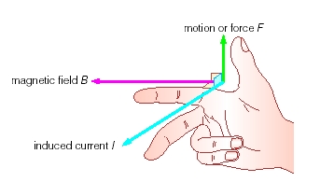
Fleming’s Right hand rule

Slide 36
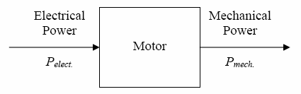
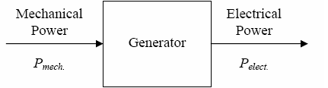
What are DC Machines?
Are DC generators that convert mechanical energy to DC electric energy.
Are DC motors that convert DC electric energy to mechanical energy.
DC machine can be used as a motor or as a generator.
DC Machine is most often used for a motor.
Notes:
EMT 462 ELECTRICAL SYSTEM TECHNOLOGY
MMR
36

Slide 37
DC MOTOR: INTRODUCTION
DC motors are found in many special industrial environments
Motors drive many types of loads from fans and pumps to presses and conveyors
The major advantages of dc machines over generators are easy to control speed and torque regulation.
However, their application is limited to mills, mines and trains. As examples, trolleys and underground subway cars may use dc motors.
In the past, automobiles were equipped with dc dynamos to charge their batteries, but now dynamos are replaced by alternators.

Slide 38
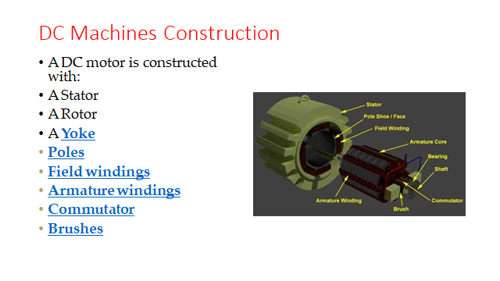

Slide 39
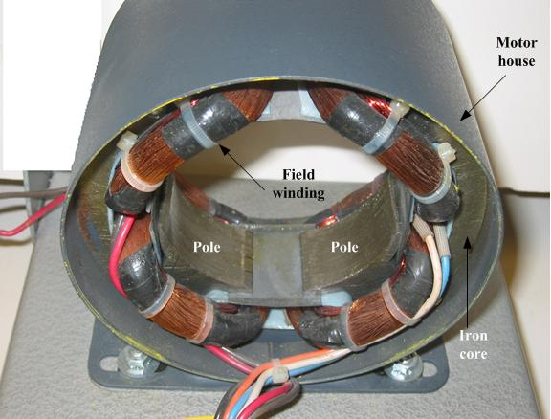
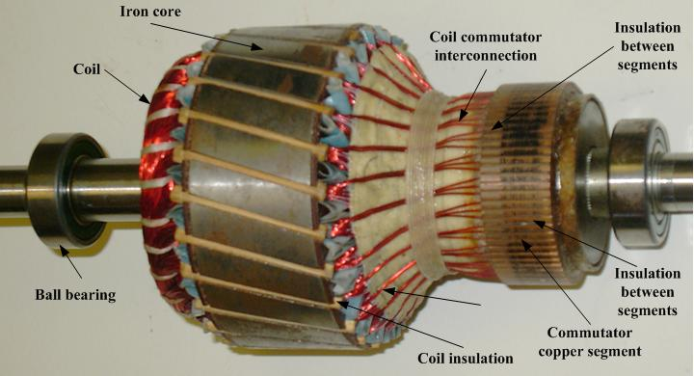
CONSTRUCTION OF DC MACHINES
DC motor stator
Rotor of a dc motor

Slide 40
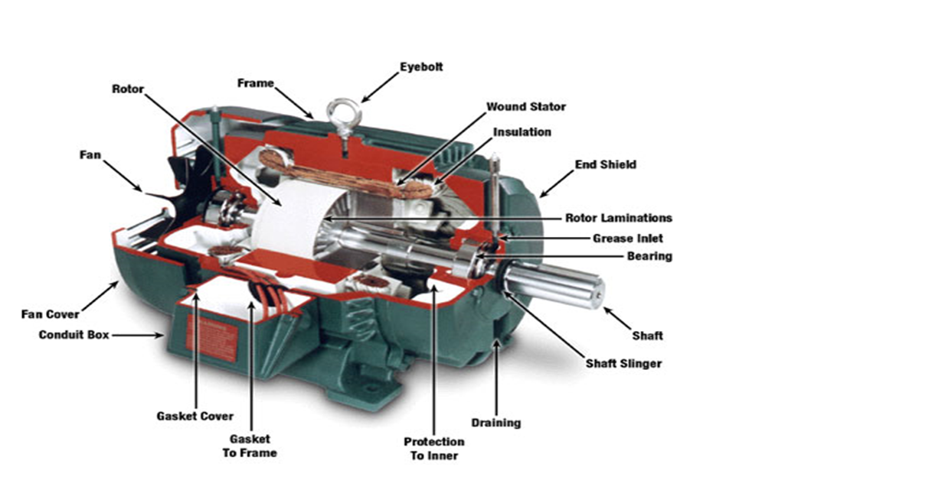
COMPONENTS OF DC MACHINE

Slide 41
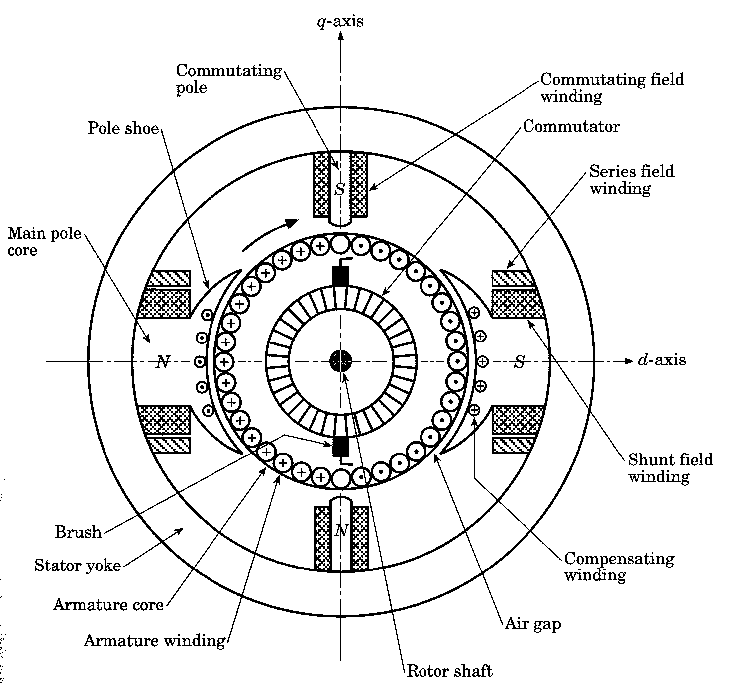
DC Machines Construction
DC machines, like other electromechanical energy conversion devices have
two sets of electrical
windings
field windings - on stator
amarture windings - on the rotor.
.
41

Slide 42
DC Machines Construction
The stator of the dc motor has poles, which are excited by dc current to produce magnetic fields.
In the neutral zone, in the middle between the poles, commutating poles are placed to reduce sparking of the commutator. The commutating poles are supplied by dc current.
Compensating windings are mounted on the main poles. These short-circuited windings damp rotor oscillations.
42

Slide 43
DC Machines Construction
The poles are mounted on an iron core that provides a closed magnetic circuit.
The motor housing supports the iron core, the brushes and the bearings.
The rotor has a ring-shaped laminated iron core with slots.
Coils with several turns are placed in the slots. The distance between the two legs of the coil is about 180 electric degrees.
43

Slide 44
DC Machines Construction
The coils are connected in series through the commutator segments.
The ends of each coil are connected to a commutator segment.
The commutator consists of insulated copper segments mounted on an insulated tube.
Two brushes are pressed to the commutator to permit current flow.
The brushes are placed in the neutral zone, where the magnetic field is close to zero, to reduce arcing.
44
Notes:
EMT 462 ELECTRICAL SYSTEM TECHNOLOGY
MMR
44

Slide 45

DC Machines Construction
The commutator switches the current from one rotor coil to the adjacent coil,
The switching requires the interruption of the coil current.
The sudden interruption of an inductive current generates high voltages .
The high voltage produces flashover and arcing between the commutator segment and the brush.
45

Slide 46


Slide 47


Principle of Operation
The generated voltage of a DC machines having (p) poles and (Z) conductors on the armature with (a) parallel path between brushes as below :
where K = pZ /(2πa) = machine constant
The mechanical torque which also equal to electromagnetic torque, is found as follows:
In the case of a generator, τ_{m} is the input mechanical torque, which is converted to electrical power. For the motor, τ_{e} is developed electromagnetic torque, which used to drive the mechanical load.
47

Slide 48
Principle of Operation
ARMATURE winding are defined as the winding which a voltage is induced.
FIELD windings are defined as the windings that produce the main flux in the machines.
The magnetic field of the field winding is approximately sinusoidal, thus AC voltage is induced in the armature winding as the rotor turns under the magnetic field of stator.
The COMMUTATOR and BRUSH combination converts the AC generated voltages to DC.
48

Slide 49


Principle of Operation
The induced or generated DC voltage (E_{A}) appearing between the brushes is a function of the field current (I_{F}) and the speed of rotation (ω) of the machine. This generated voltage is :
Where
K’ = voltage constant
ω = rotation per min
If the losses of the DC machine are neglected, the electrical power is equal to the mechanical power
49

Slide 50

WORKING OF DC MOTOR
50

Slide 51

Current in DC Motor
51

Slide 52

Magnetic Field in DC Motor
52

Slide 53

Force in DC Motor
53

Slide 54
Types of DC Motors
DC motors are classified according to electrical connections of armature windings and field windings.
Armature windings: a winding which a voltage is induced
Field windings: a winding that produces the main flux in machines
Five major types of DC motors:-
Separately excited DC motor
Shunt DC motor
Permanent Magnet DC motor
Series DC motor
Compounded DC motor
Chap 2: DC Machines
54
Notes:
EMT 462 ELECTRICAL SYSTEM TECHNOLOGY
MMR
54

Slide 55
Types of DC Machines
Self-excited DC machine: when a machine supplies its own excitation of the field windings. In this machine, residual magnetism must be present in the ferromagnetic circuit of the machine in order to start the self-excitation process.
Separately-excited DC machine: The field windings may be separately excited from an eternal DC source.
Shunt Machine: armature and field circuits are connected in parallel. Shunt generator can be separately-excited or self-excited.
Series Machine: armature and field circuits are connected in series.
Notes:
55

Slide 56
Applications of DC Motors
Shunt Motor:
Blowers and fans
Centrifugal and reciprocating pumps
Lathe machines
Machine tools
Milling machines
Drilling machines

Slide 57
Applications of DC Motors
Series Motor:
Cranes
Hoists , Elevators
Trolleys
Conveyors
Electric locomotives

Slide 58
Applications of DC Motors
Cumulative compound Motor:
Rolling mills
Punches
Shears
Heavy planers
Elevators

Slide 59
A magnetic field exists around
iron
copper
aluminium
moving charges

Slide 60
Ans: d

Slide 61
Which of the following is a vector quantity ?
Relative permeability
Magnetic field intensity
Flux density
Magnetic potential

Slide 62
Ans: b

Slide 63
The ratio of intensity of magnetisation to the magnetisation
force is known as
flux density
susceptibility
relative permeability
none of the above

Slide 64
Ans: b

Slide 65
The unit of relative permeability is
henry/metre
henry
henry/sq. m
it is dimensionless

Slide 66
Ans: d

Slide 67
Degaussing is the process of
removal of magnetic impurities
removing gases from the materials
remagnetising metallic parts
demagnetising metallic parts

Slide 68
Ans: d

Slide 69
Gilbert is a unit of
electromotive force
magnetomotive force
conductance
permittivity

Slide 70
Ans: b

Slide 71
Reciprocal of permeability is
reluctivity
susceptibility
permittivity
conductance

Slide 72
Ans: a

Slide 73
The commonly used material for shielding or screening magnetism is
copper
aluminium
soft iron
brass

Slide 74
Ans: c

Slide 75
DC Generators
DC generators are dc machines used as generator. There are five major types of dc generators, classified according to the manner in which their field flux is produced:
Separately excited generator: In separately excited generator, the field flux is derived from a separately power source independent of the generator itself.
Shunt generator: In a shunt generator, the field flux is derived by connecting the field circuit directly across the terminals of the generators.
Series generator: In a series generator, the field flux is produced by connecting the field circuit in series with the armature of the generator.
Cumulatively compounded generator: In a cumulatively compounded generator, both a shunt and series field is present, and their effects are additive.
Differentially compounded generator: In differentially compounded generator: In a differentially compounded generator, both a shunt and a series field are present, but their effects are subtractive.
Chap 2: DC Machines
75

Slide 76


Slide 77





DC GENERATOR: Generation of Unidirectional Voltage
As the rotor is rotated at an angular velocity (ω), the armature flux linkage (Φ) change and a voltage e_{aa}’ is induced between terminal a and a’. The expression for the voltage induced is given by Faraday’s Law
Flux linkage of coil aa’; b) induced voltage;
c) rectified voltage
77
Two pole DC generator

Slide 78



Generation of Unidirectional Voltage
The internal generated voltage in the DC machines defined as:
Where E_{A} = armature voltage
K = motor constant
= flux
= rotation per min
78

Slide 79
Applications of DC Generator
Shunt Generators:
a. in electro plating
b. for battery recharging
c. as exciters for AC generators.
Series Generators :
A. As boosters
B. As lighting arc lamps

Slide 80
Starting of DC motors
A starter is a device to start and accelerate a motor. A controller is a device to start the motor, control and reverse the speed of the DC motor and stop the motor. While starting the DC motor, it draws the heavy current which damages the motor.
The starter reduces the heavy current and protects the system from damage.
Need of Starters for DC Motors:
The dc motor has no back emf. At the starting of the motor, the armature current is controlled by the resistance of the circuit. The resistance of the armature is low, and when the full voltage is applied at the standstill condition of the motor, the armature current becomes very high which damage the parts of the motor.
Since at the time of starting the DC Motor, the starting current is very large. At the time of starting of all DC Motors, except for very small motors, an extra resistance must be connected in series with the armature. This extra resistance is added so that a safe value of the motor is maintained and to limit the starting current until the motor has attained its stable speed.

Slide 81
Speed Control of DC motors
According to the speed equation of a dc motor
N ∞ Eb/φ
∞ V- Ia Ra/ φ
Thus speed can be controlled by:
Flux control method: By Changing the flux by controlling the current through the field winding.
Armature control method: By Changing the armature resistance which in turn changes the voltage applied across the armature

Slide 82
Flux Control Method
Advantages:
It provides relatively smooth and easy control
Speed control above rated speed is possible
As the field winding resistance is high the field current is small. Power loss in the external resistance is small . Hence this method is economical
Disadvantages:
Flux can be increased only upto its rated value
High speed affects the commutation, motor operation becomes unstable

Slide 83
Armature Voltage Control Method
The speed is directly proportional to the voltage applied across the armature .
Voltage across armature can be controlled by adding a variable resistance in series with the armature
Potential Divider Control
If the speed control from zero to the rated speed is required , by rheostatic method then the voltage across the armature can be varied by connecting rheostat in a potential divider arrangement .

Slide 84
No-load speed of which of the following motor is highest?
Differentially compound motor
Cumulative compound motor
Series Motor
Shunt Motor

Slide 85
Series Motor
Explanation:
At the time of starting, flux is very less in DC series motor.
So as we know the inverse relationship between speed
and flux i.e flux decrease when speed increase.
Therefore we never start DC series motor at no load.

Slide 86
Which of the following load normally need starting torque
more than the rated torque?
Conveyors
Blowers
Centrifugal pump
Air compressor

Slide 87
Conveyors Explanation:
Starting torque is also called the locked-rotor torque and the motor current at this point is referred to as the ‘locked rotor current. At this stage, the rotor reactance is higher than its resistance, as the rotor frequency is at its highest (equals the supply frequency).
Starting torque is the amount of torque required to
overcome the inertia of a standstill motor.
Conveyors require high starting torque because the material is placed before the starting of the Conveyors belt.
So obviously we require more torque to overcome the
load at the starting period.
Therefore conveyor required high starting torque and constant speed.
Series motor is suitable for conveyor belts operating in a particular region of its torque-speed characteristics.
In industries BLDC is used, as BLDC provides PWM
speed controlling method which is easier to vary the speed as well as with low maintains.

Slide 88
Which of the following rule is used to determine the
direction of rotation of D.C motor?
Coloumb’s Law
Lenz’s Law
Fleming’s Right-hand Rule
Fleming’s Left-hand Rule

Slide 89
Fleming’s left-hand rule.
Explanation:
When a current-carrying conductor such as a wire attached to a circuit moves placed in a magnetic field, an electric current is induced in the wire due to Faraday’s law of induction.
The right hand is held with the thumb, first finger and second finger mutually perpendicular to each other than
The thumb is pointed in the direction of the motion of the conductor relative to the magnetic field i.e direction of the force.
The forefinger is pointed in the direction of the magnetic field.
The middle finger represents the direction of the induced or generated current within the conductor.

Slide 90
Which part of DC motor can sustain maximum
temperature rise?
Armature Winding
Field winding
Slip Ring
Commutator

Slide 91
Commutator
Explanation:
The commutator is made up of copper segments.
This copper segment is insulated from each other with the help of mica.
Mica has a very high dielectric stress of about 1180
kV/cm and the next best is Diamond.
It can withstand high temperatures, up to 600 deg C.

Slide 92
The ratio of starting torque to full load torque is least in
Differential Compound Motor
Shunt motor
Series Motor
Cumulative compound motor

Slide 93
Differential Compound motor
Explanation:
In the differential compound, motor two field windings i.e shunt and series windings oppose each other.
This causes a reduction in flux and consequences
decrease in torque

Slide 94
The efficiency of the DC motor at maximum power is
90%
100%
Around 80%
Less than 50%

Slide 95
Less than 50% Explanation:
Why efficiency of D.C motor is below 50%
The DC motor develops maximum power when the Back
EMF is half the applied voltage is E_{b} = V/2.
Practically it is not possible to develop an exact 50% of maximum power because in that case, the current would be much beyond the rated current of the motor.
Some of the energy is wasted in the form of heat and other losses. Therefore motor efficiency is below 50%.

Slide 96
In which of the following application DC series motor is used?
Centrifugal Pump
Motor Operation in DC and AC
Water pump drive
Starter for car

Slide 97
Starter for car
Explanation:
In DC series motor Torque (Ta) increase as the Square of armature current (Ia) T_{a} 𝖺 I_{a}².
So DC motor provides high starting torque which is
required to start a car.

Slide 98
A three-point starter is suitable for
Shunt Motor
Series Motor
Shunt & Compound Motor
Shunt, Series, and compound motor

Slide 99
Shunt & Compound motor Explanation:
3 point starters in DC Shunt and Compound machines
serve for the following purposes.
It limits the high starting current into the armature by having the resistance high at the time of starting and reducing it during the running conditions.
It also protects the motor from overload and under-
voltage conditions.

Slide 100
Which DC motor has the least percentage increase in
Input current for the same percentage increase in torque?
Separately excited motor
Series motor
Shunt motor
Compound motor

Slide 101
Answer 2. Series motor Explanation:
In DC series motor both field and armature windings carry the same current from source as both are connected in series.
Therefore torque is directly proportional to the product of current in field and armature windings.
For a given source current the torque produced is square of this current. So, even there is low current change, the torque change is great.

Slide 102
By looking at which particular part of the motor we can
Identify a “DC motor”?
Shaft
Field winding
Commutator
Armature winding

Slide 103
Commutator Explanation:
The commutator converts the alternating current generated in armature into the unidirectional current.
It is a mechanical rectifier, so the commutator collects
induced EMF or current developed in the armature.
In the DC motor, the commutator is used to alternate the magnetic field created by the DC current.
For AC motor the magnetic field is already alternated by the nature of the AC current.

Slide 104
Counter EMF of the DC motor is
Less than the applied voltage
More than the applied voltage
Equal to the applied voltage
None of the above

Slide 105
Less than the applied voltage Explanation:
According to DC motor equation,
I_{a} = (V – E_{b})/R_{a}
⇒ V = E_{b} + I_{a}R_{a}

Slide 106
If the back EMF of DC motor vanishes then
The motor continues to run
Motor will stop
Armature will burn
The motor continues to run in slow speed

Slide 107
The armature will burn Explanation:
Explanation:
The presence of back emf makes the d.c. motor a self- regulating machine i.e., it makes the motor to draw as much armature current as is just sufficient to develop the torque required by the load.
Armature current is I_{a} = (V – E_{b})/R_{a}
When the motor is running on no-load, small torque is required to overcome the friction and windage losses.
As Eb is zero the armature current will increases to a very high value, therefore a large amount of heat will be produced which may burn the armature winding.

Slide 108
Why is the speed of DC shunt motor dependent on Back
EMF?
Because flux is proportional to the armature current
Because armature drop is negligible
Because Back EMF is equal to armature current
Because flux is constant in DC shunt motor

Slide 109
Because flux is constant in DC shunt motor. Explanation:
In the case of DC motors Speed 𝖺 Back emf(E_{b})/flux(φ).
The field winding is connected across the armature. The resistance offered by the field is constant so the current is constant. As current is constant flux also becomes
constant b the cause flux is directly proportional to current.
Therefore the speed of the DC shunt motor depends on
the back EMF.

Slide 110

An induction motor or asynchronous motor is an AC electric motor in which the electric current in the rotor needed to produce torque is obtained by electromagnetic induction from the magnetic field of the stator winding
INDUCTION MOTORS

Slide 111

Single Phase Induction Motor
The single-phase induction machine is the most frequently used motor for refrigerators, washing machines, clocks, drills, compressors, pumps, and so forth.
The single-phase motor stator has a laminated iron core with two windings arranged perpendicularly.
One is the main and
The other is the auxiliary winding or starting winding
111

Slide 112

Construction of Single Phase Induction Motor
112

Slide 113

Single Phase Induction Motor
This “single-phase” motors are truly two-phase machines.
The motor uses a squirrel cage rotor, which has a laminated iron core with slots.
Aluminum bars are molded on the slots and short-circuited at both ends with a ring.
Single-phase induction motor.
*

Slide 114

Single Phase Induction Motor
Squirrel cage rotor
*

Slide 115
Operating principle
*
115

Slide 116
7.6 Single Phase Induction Motor
The single-phase induction motor operation can be described by two methods:
Double revolving field theory; and
Cross-field theory.
Double revolving theory is perhaps the easier of the two explanations to understand
Learn the double revolving theory only
*
116

Slide 117
Single Phase Induction Motor
Double revolving field theory
A single-phase ac current supplies the main winding that produces a pulsating magnetic field.
Mathematically, the pulsating field could be divided into two fields, which are rotating in opposite directions.
The interaction between the fields and the current induced in the rotor bars generates opposing torque
*
117

Slide 118

Single Phase Induction Motor
The interaction between the fields and the current induced in the rotor bars generates opposing torque.
Under these conditions, with only the main field energized the motor will not start
However, if an external torque moves the motor in any direction, the motor will begin to rotate.
Single-phase motor main winding generates two rotating fields, which oppose and counter-balance one another.
118

Slide 119


Slide 120

Three Phase Induction Motor

Slide 121


Slide 122


Slide 123


Construction

Slide 124


Slide 125
Advantages of Three-Phase Induction Motor: These motors are self-starting and use no capacitor, start winding, centrifugal switch or other starting device.
APPLICATIONS
Three-phase AC induction motors are widely used in industrial and Commercial applications.

Slide 126


